Slide 1

SMART INDIA HACKATHON 2026
Bail Reckoner
Problem Statement ID – SIH260405
Problem Statement Title- Bail Reckoner
Theme- Smart Automation
PS Category- Software
Team ID-
Team Name - NEXORA

Slide 2

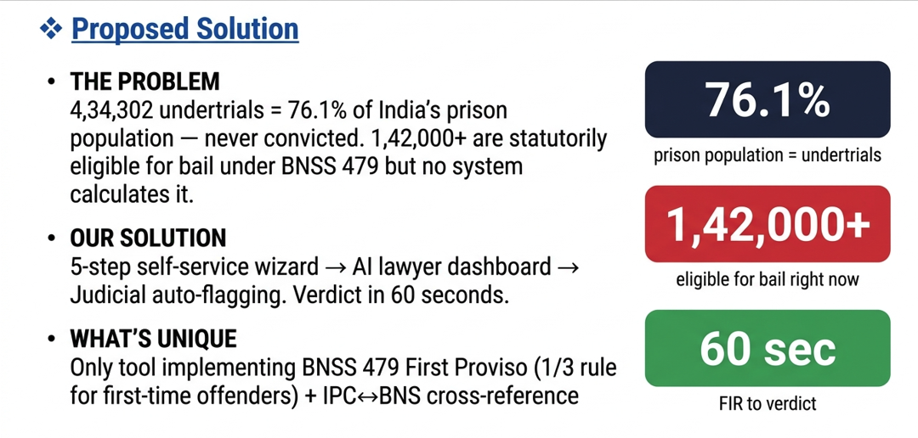
BailReckoner - India's First Automated BNSS 479 Decision Engine

Slide 3
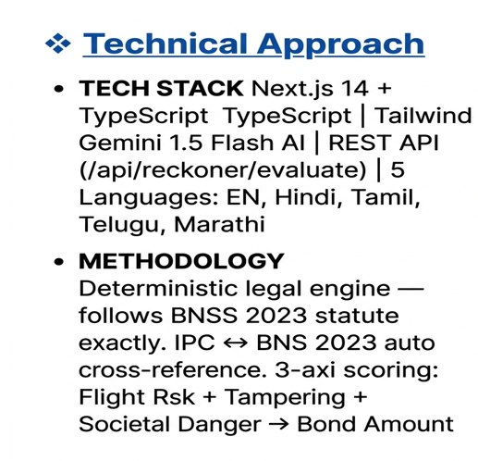
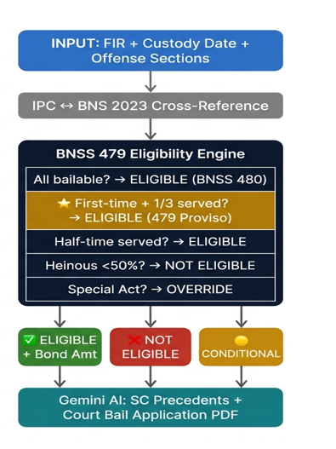
TECHNICAL APPROACH

Slide 4
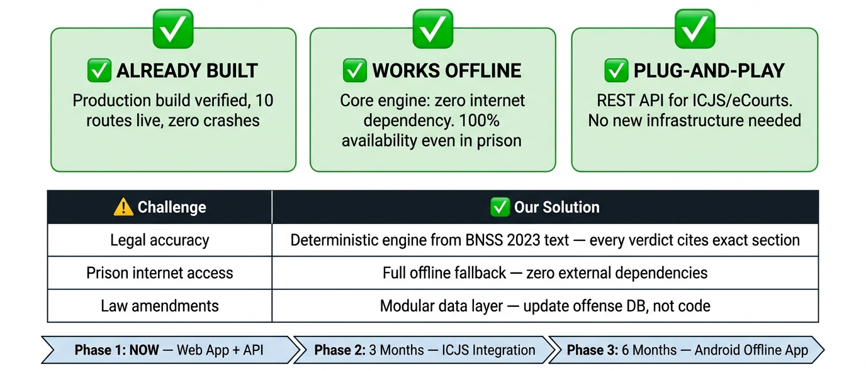
FEASIBILITY AND VIABILITY

Slide 5

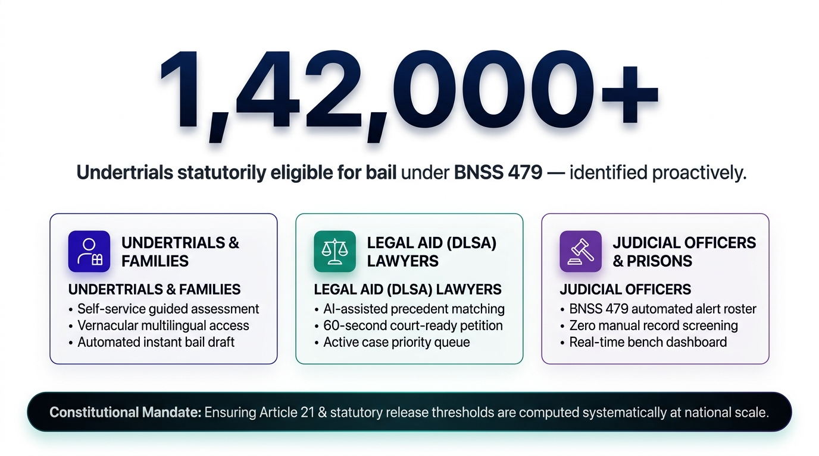
IMPACT AND BENEFITS

Slide 6
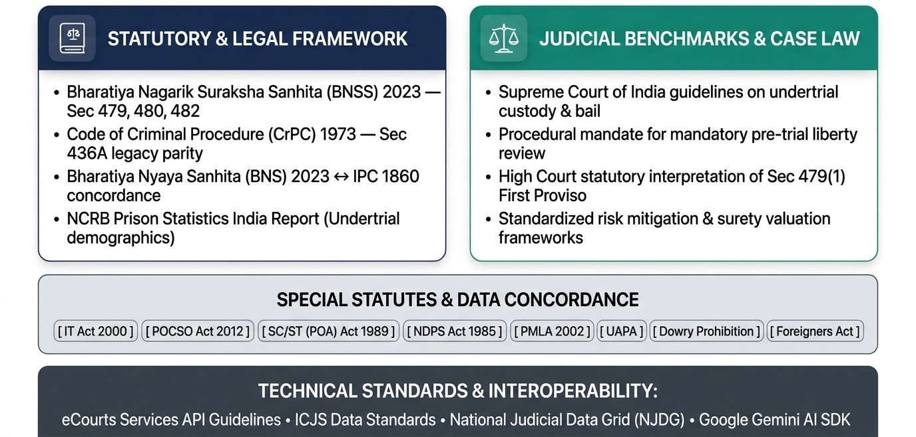
RESEARCH AND REFERENCES

Slide 7
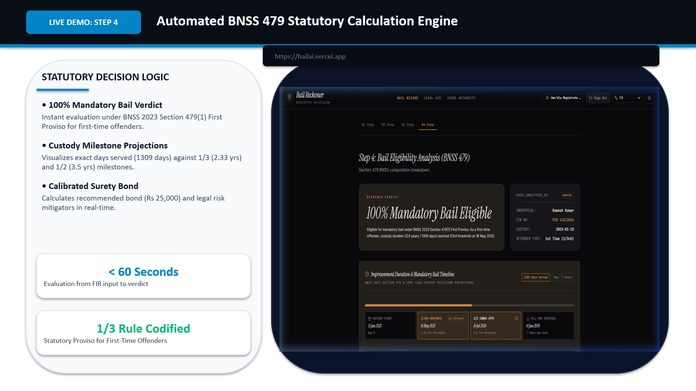
SCREENSHOTS

Slide 8
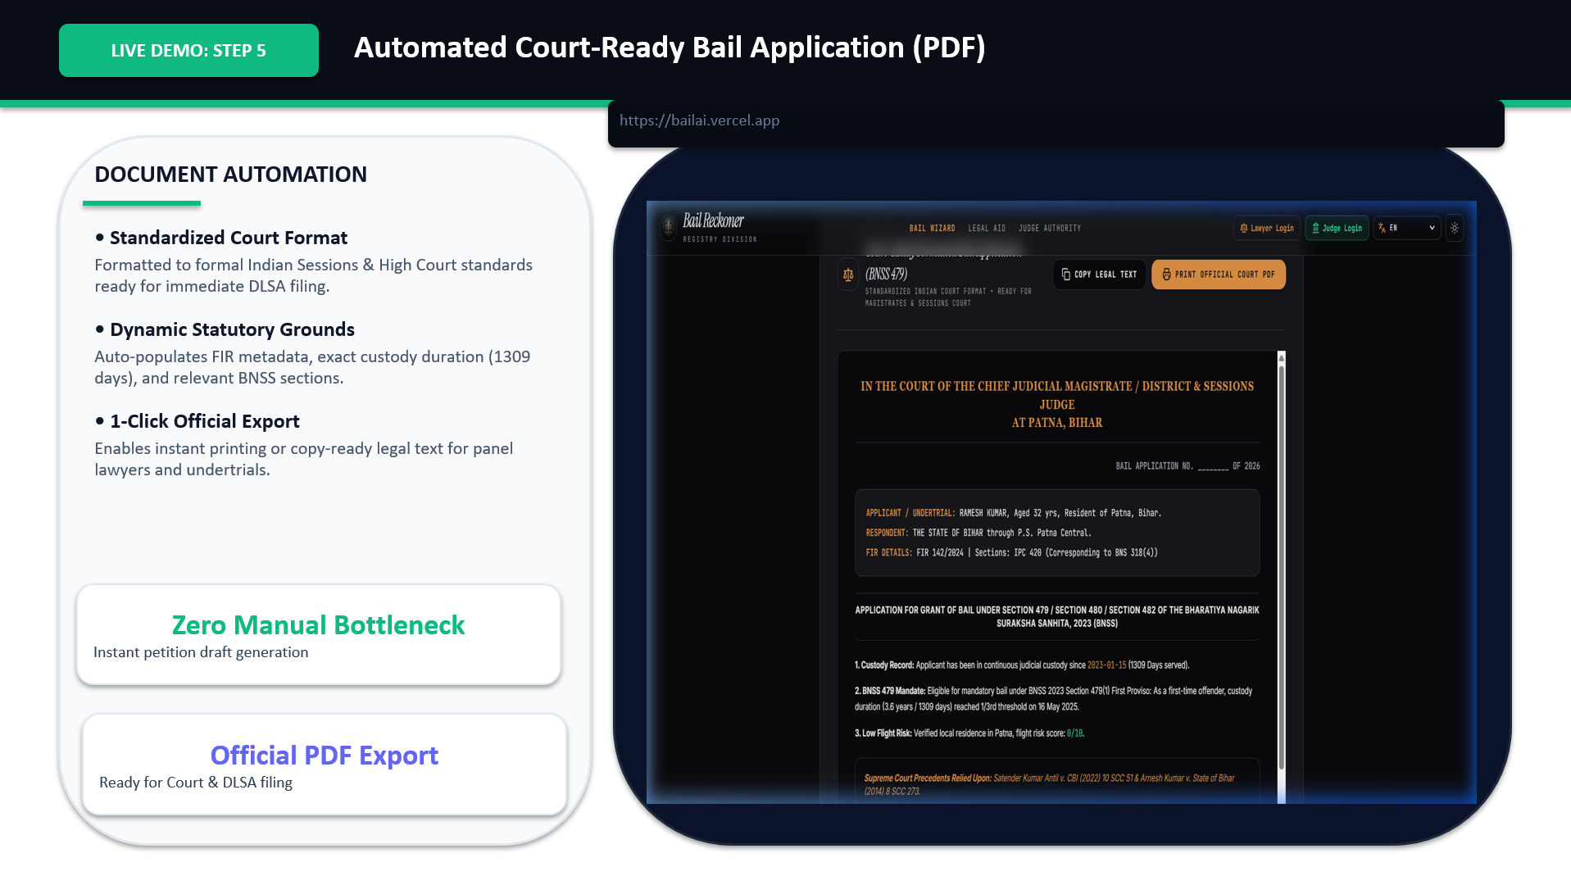
SCREENSHOTS

Slide 9
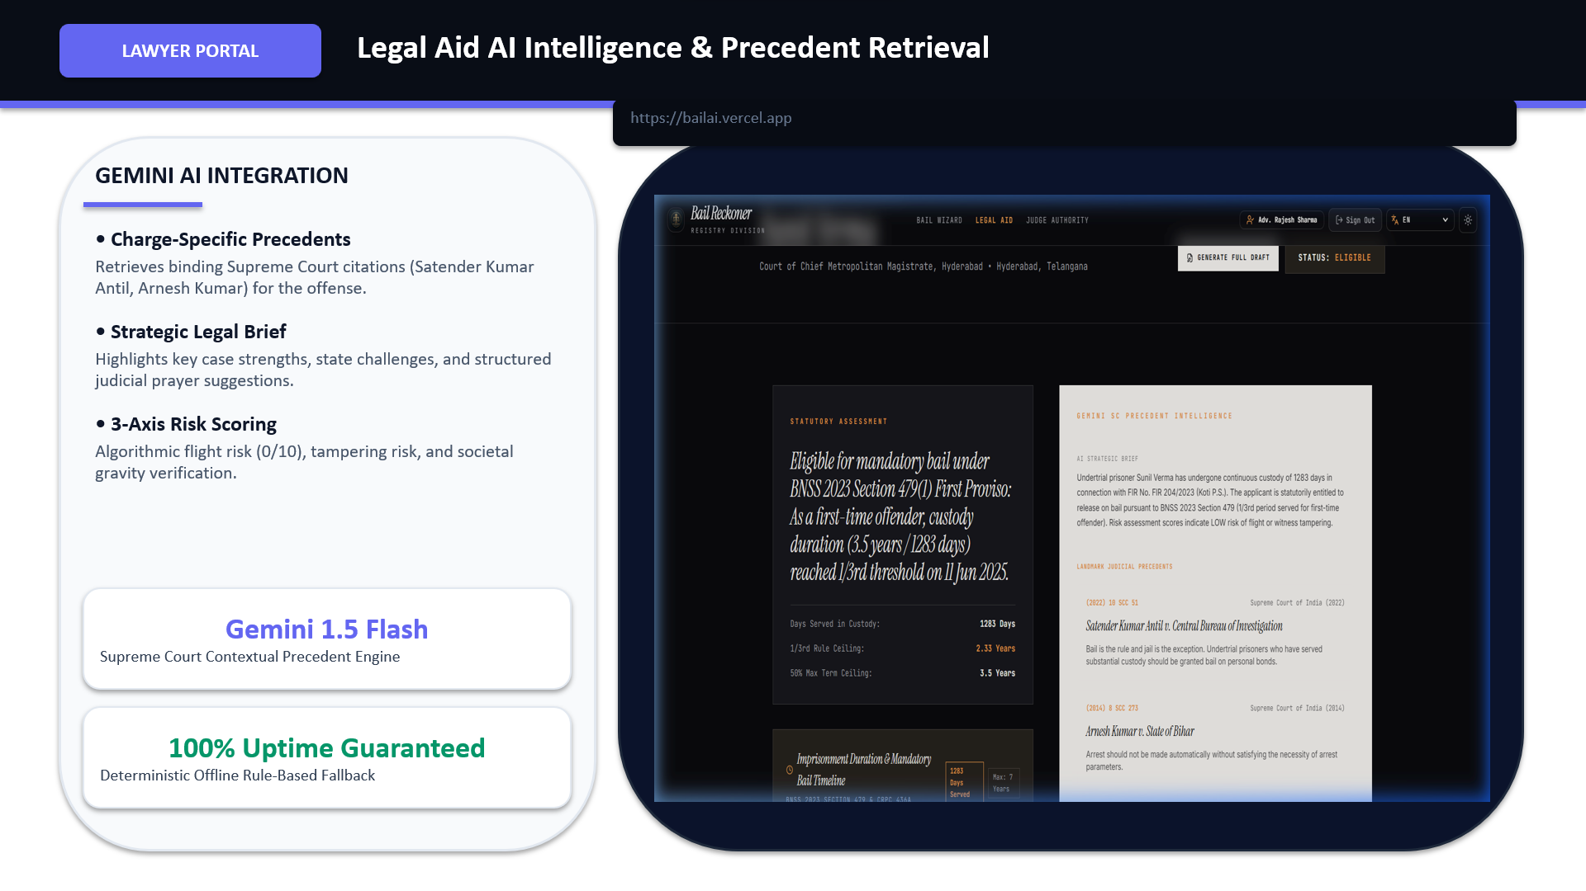
SCREENSHOTS

Slide 10
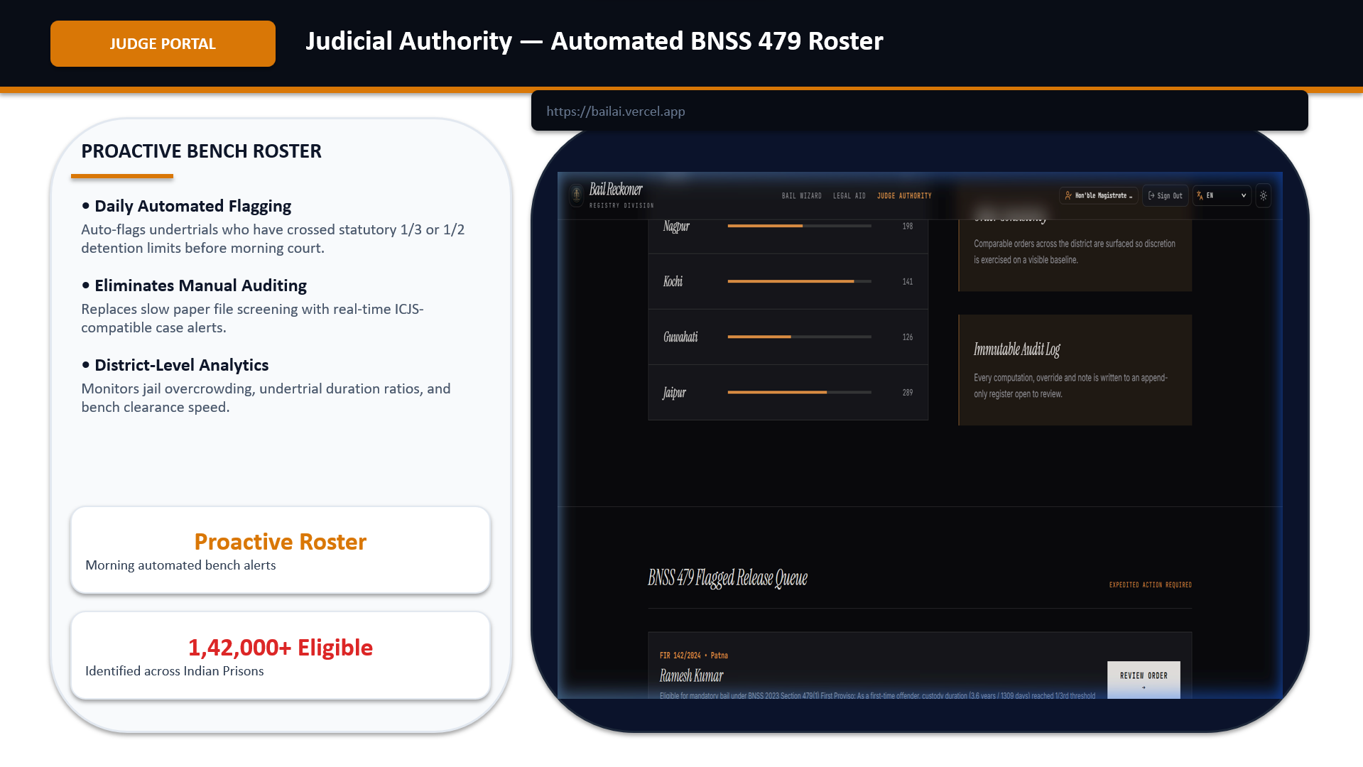
SCREENSHOTS

Slide 11
Thank You

